Slide 1
Basics of Pulse Heat Joining Technology July 2023
Presented By

Slide 2
Contents
Theory of Pulse Heat, Basic Operation
Soldering
Heat Caulking
Thermo-compression Bonding
Dissimilar Material Joining
Pulse Heat – Points to Consider

Slide 3
Theory of Pulse Heat Basic Operation

Slide 4
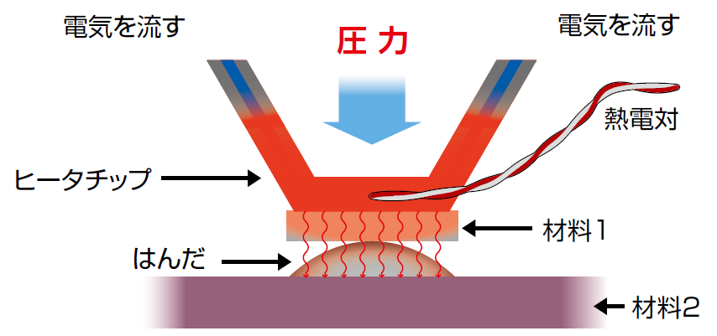
Theory of Pulse Heat
An electric current is passed through a metallic resistive element to heat it using Joule heating
Familiar Joule heating…
Filament generates heat
Electric Current
Pressure
Electric Current
Thermocouple
Heater Tip
Electric heating wire generates heat
Solder
Material 1
Material 2
Pulse Heat uses that heat to warm up the object material (work)

Slide 5
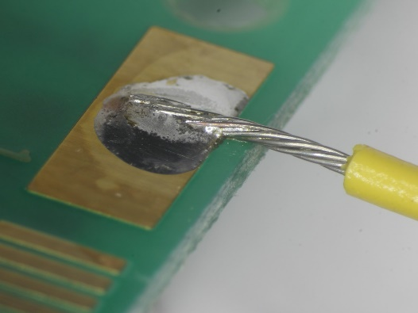
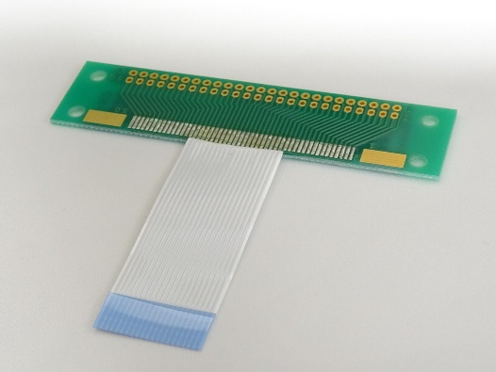
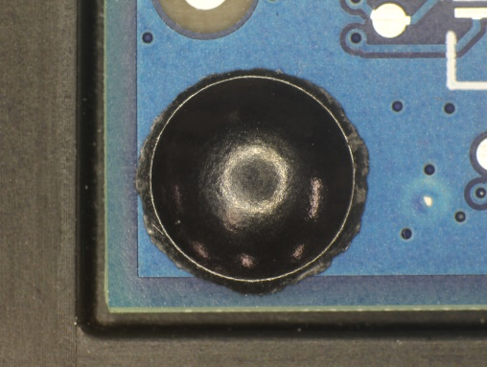
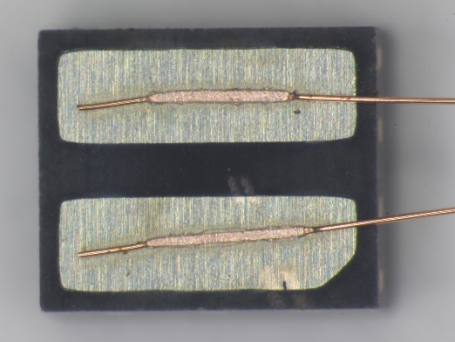
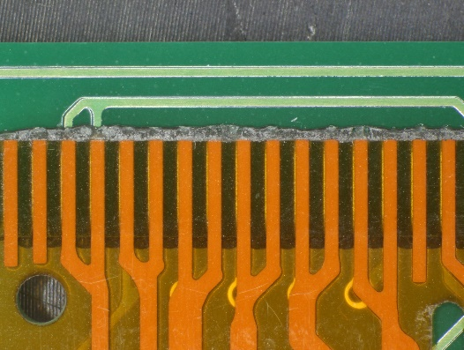
Application of Pulse Heat
Soldering
Joining PCB and Cable
Joining terminal to terminal
Joining between busbars
Heater Tip
Resin Fusing
Sealing of fixing holes for PCB and components
Thermo-compression Bonding
Compression bonding of terminal connecting film (ACF, etc.)

Slide 6
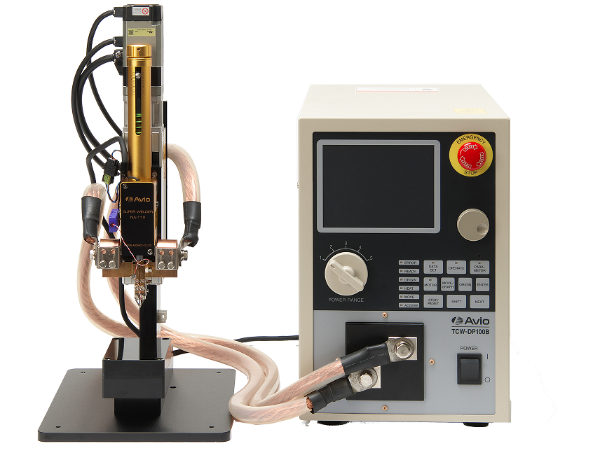
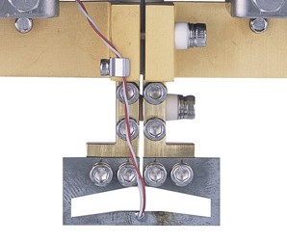
Basic Configuration
Head
Welding Controller
Pressure Mechanism
(Motor or Air Drive)
Power Supply Controller
(Target temperature
Heating time)
Heater Tip
Heating element
(Sizes to fit the workpiece)

Slide 7
Basic Operation (Process Flow)
-01- Tooling set
-02- Heater tip touchdown
-03- Holding pressure and heat
-04- Holding pressure while cooling
-05- Release pressure ・ End
STEP 01
Set the work on the jig
Heater tip touches down on work
When set pressure is reached, heating is performed at the pre-determined temperature profile.
After heating is completed, pressure is maintained while the heater tip is cooled.
When it reaches to the cooling temperature, head pressure is released to complete.
STEP 02
STEP 03
STEP 04
STEP 05

Slide 8
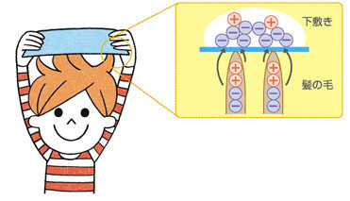
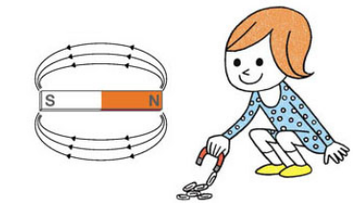
Electric Field and Magnetic Field
Electric Field
Electricity has positive and negative polarity. Objects of different polarity attract each other, and objects of the same polarity repel each other. The place where these electrical forces are at work is called an electric field
Magnetic Field
Magnets have N and S poles; those with different poles attract each other and those with the same poles repel each other. The place where these magnetic forces work is called a magnetic field

Slide 9
Difference Between Induction Heating and Dielectric Heating - 1
Classification of Frequency and Heating
1Hz | 10Hz | 100HZ | 1kHz | 10kHz | 100kHz | 1MHz | 10MHz | 100MHz | 1GHz | 10GHz
High-frequency induction heating
High-frequency dielectric heating
Microwave Dielectric heating
1000Hz | （Hertz） | ＝ | 1kHz | （Kilohertz）
1000kHz | （Kilohertz） | ＝ | 1MHz | （Megahertz)
1000MHz | （Megahertz） | ＝ | 1GHz | （Gigahertz）
1000GHz | （Gigahertz） | ＝ | 1THz | （Teraherts）
Induction heating uses frequencies of a few MHz or lower.
Dielectric heating uses frequencies of several MHz or higher, and the term “high-frequency” changes to “microwave” at around 1 GHz

Slide 10
Difference Between Induction Heating and Dielectric Heating
Differences by principle
Induction Heating = heating of conductive materials by changing the magnetic field
Dielectric Heating = heating of dielectric material by a change in electric field
Category | Induction Heating | Dielectric Heating
Primary Cause of Heating | Change in magnetic field (alternating magnetic field) | Change in electric field (alternating electric field)
Object Being heated | Conductor (mainly metals) | Dielectric (mainly insulators)
Heat-Generating factor | Joule heat from eddy current | Dielectric loss
Frequency Range | Several tens Hz to several MHz | Several MHz to several hundred MHz (High-frequency dielectric heating) Several hundred MHz to several tens of GHz (Microwave dielectric heating)
Applications | ・IH rice cooker ・Induction cooker (IH heater) ・Industrial metal melting furnace ・Quenching of automotive parts, etc. | ・Microwave Oven ・Wood drying ・Drying of paper/corrugated cardboard ・Stretching of nylon, etc.

Slide 11
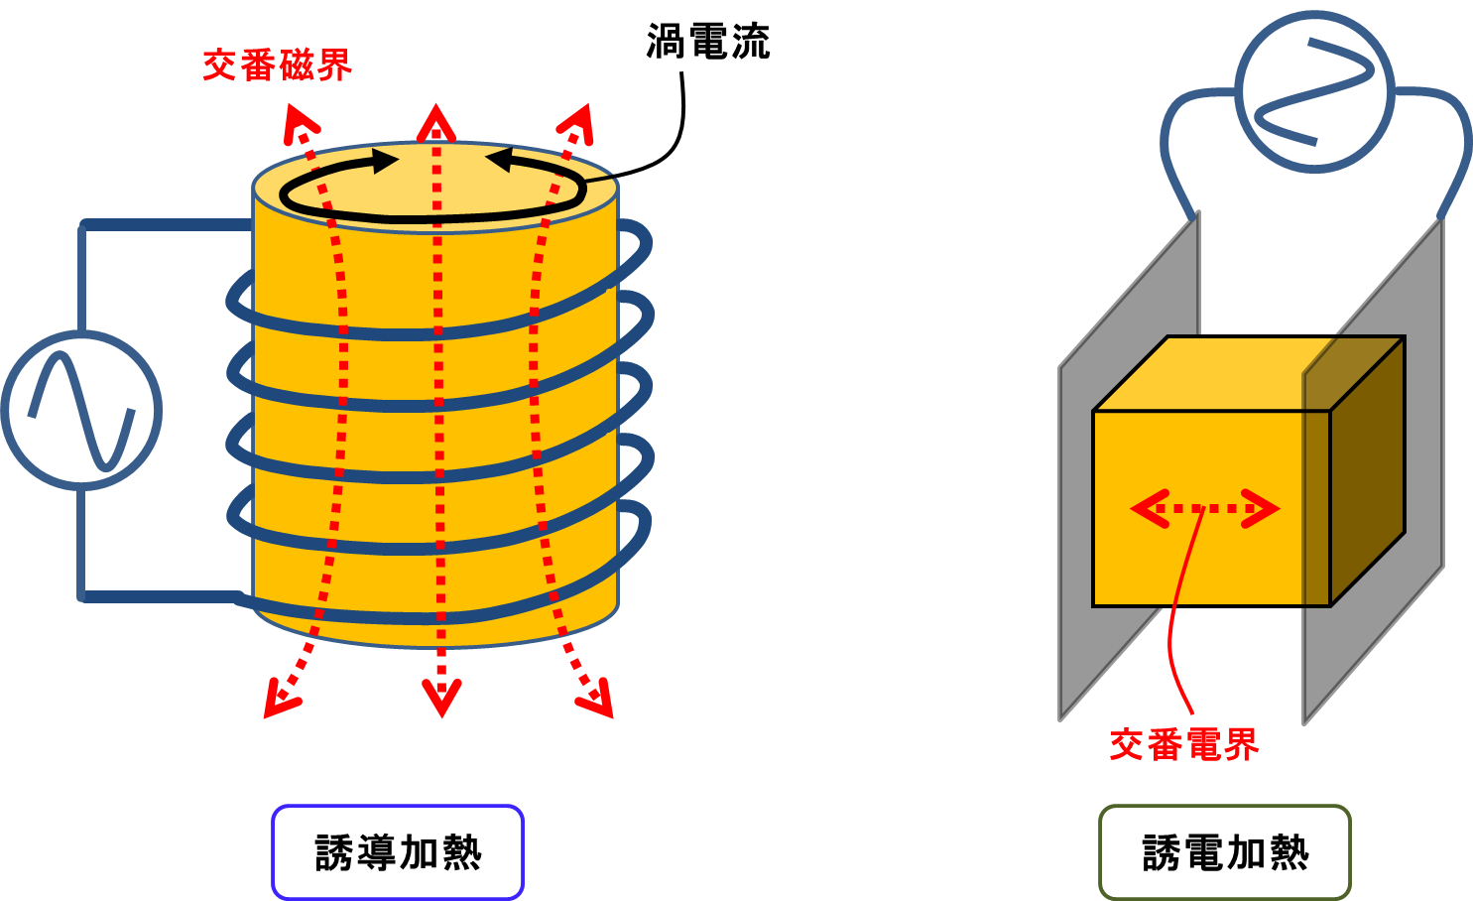
Difference Between Induction and Dielectric Heating (cont.)
Differences by Principle (Illustration)
The use of AC (alternate current) is the same, but the usage is totally different
Eddy Current
Alternate Magnetic Field
Alternating Electric Field
Induction Heating
Dielectric Heating

Slide 12
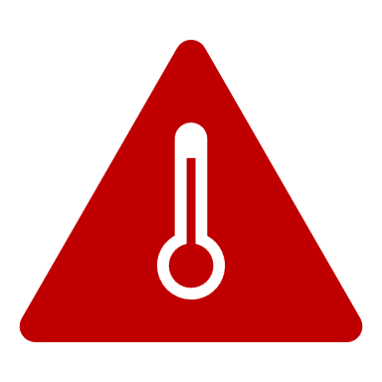
About
“Induction Heating”

Slide 13
About Induction Heating
What is Induction Heating?
Induction heating is a non-contact heating method in which an alternating current is passed through a coil to generate an alternating magnetic field, which is applied to an electrical conductor to generate eddy current, which heat the conductor itself by Joule heat.
A typical form of induction heating is shown in the figure below.
Low Frequency Induction Heating
High Frequency Induction Heating
By Joule heating from internal eddy current, heat can be generated from inside the object, enabling highly efficient and rapid heating and reducing scales on the surface, etc. The depth of heating from the surface can be controlled by changing the frequency. When the frequency is increased, eddy currents are concentrated on the surface due to the skin effect, and only the surface area is heated, as shown on the right end of the above figure.

Slide 14
About Induction Heating (cont.)
Electrical View of Induction Heating
The figure below shows how induction heating is represented electrically by an equivalent circuit
Heating element as well as object to be heated
Electrically, it is the same as a transformer. The coil generates a magnetic field, which induces a current in the secondary side (i.e., the object to be heated), which is exactly what a transformer does, and the equivalent circuit can be expressed as the consumption of Joule heat in the secondary side of the transformer, as shown in the figure above.
Then why does the iron core of a normal transformer not heat up red hot? The reason is that the iron core of a transformer is made of very thin steel plates of about 0.2~0.3 mm laminated with insulators to prevent eddy currents from increasing.

Slide 15
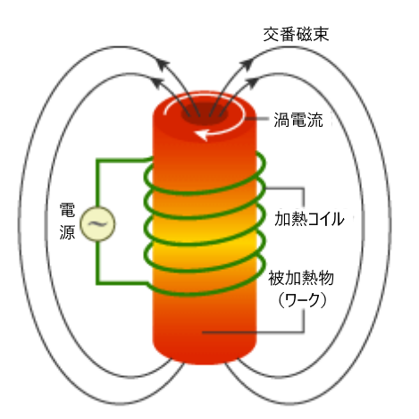
Principle of Induction Heating
Alternate current flowing in heating coil generates magnetic lines of force (magnetic field) around the coil.
When a metal (object to be heated) is placed in or near the coil, eddy current (current in the opposite direction of the coil current are generated in the metal in a direction that prevents magnetic flux from changing.
This eddy current and the electrical resistance of the metal generate Joule heat (eddy current loss), and the metal rapidly heats itself
Alternating magnetic field
This is direct heating method in which an electric current is applied to the object to be heated, and it must be a conductive material. When inductively heating insulators such as ceramics, indirect heating method is used, in which the object to be heated is placed in a conductive container and heat is transferred by inductively heating the container
Eddy
Current
Heating Coil
In the case of heating magnetic materials, the phenomenon of rapid heating due to the heat generated in the conductor by hysteresis loss (the amount of heat generated as each molecule in the magnetic material vibrates and friction due to the AC magnetic flux) in addition to eddy current is used.
Object to be heated
(Work)

Slide 16
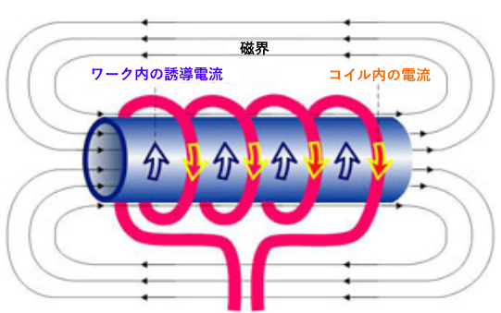
What is Eddy Current?
Eddy current is magnetic field around the coil when an alternating current is applied to the heating coil. When a metal (object to be heated) is placed in or near the coil, a concentric circular current is generated in the metal in a direction that prevents (cancels out) the magnetic flux change. This is an eddy current (current in the opposite direction of the coil current).
Magnetic Field
Induced current in work
Current in Coil
Eddy current and the electrical resistance of the metal generate Joule heat (eddy current loss), and the metal rapidly self-heats (principle of induction heating).

Slide 17
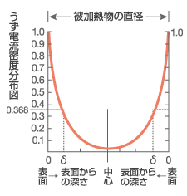
What is Skin Effect?
Skin effect is a phenomenon in which eddy currents are larger near the surface and exponentially smaller toward the interior. The point at which the eddy current density decreases to 0.368 times the current density at the surface is called the penetration depth δ. Approximately 90% of the self-heating occurs from the surface to this 。The penetration depth δ is inversely proportional to the square root of frequency.
Diameter of object to be heated
Eddy current density distribution
Formula of skin effect
δ=5.03
ρ
Μ・ƒ
ρ：Specific resistance of metal（μΩ・cm）
μ：Relative permeability
ƒ：Frequency（Hz）
Depth from Surface
Depth from Surface
Surface
Center
Surface
Eddy current cancel each other at the center and strengthen each other on the outside so that all currents are concentrated on the conductor skin. The higher the frequency, the stronger this effect is.

Slide 18
What is Hysteresis Loss?
Hysteresis loss occurs only in magnetic materials such as steel and nickel. When an alternating current is applied to a coil, an alternating magnetic field (a magnetic field that repeatedly changes in magnitude and direction with time) is generated.
This phenomenon is caused by friction between molecules when the material is first magnetized in one direction and then in the other direction (loss = heat generation). Molecules can be viewed as small magnets that change direction each time the direction of the magnetic field reverses. Work (energy) is required to change it for the better. Energy is converted into heat. The rate of energy (power) consumption increases with the percent reversal (frequency).
Hysteresis loss
Due to the hysteresis (a change in a magnetic material that depends not only on the force currently applied, but also on the force applied in the past) of magnetic material, the magnetic flux density draws a hysteresis loop.
Since hysteresis loss = area enclosed by the hysteresis loop, the smaller the area, the smaller the hysteresis loss.
When an alternating current is applied to a coil, the hysteresis loss draws hysteresis loop which is area enclosed by the hysteresis loop.
Magnetic field density B[T]
Hysteresis loop
Hysteresis loss
Coil (Inductor)
Magnetic field density B[T]
Magnetic field strength H[A/m]
Current I[A]

Slide 19
About
“Dielectric Heating”

Slide 20
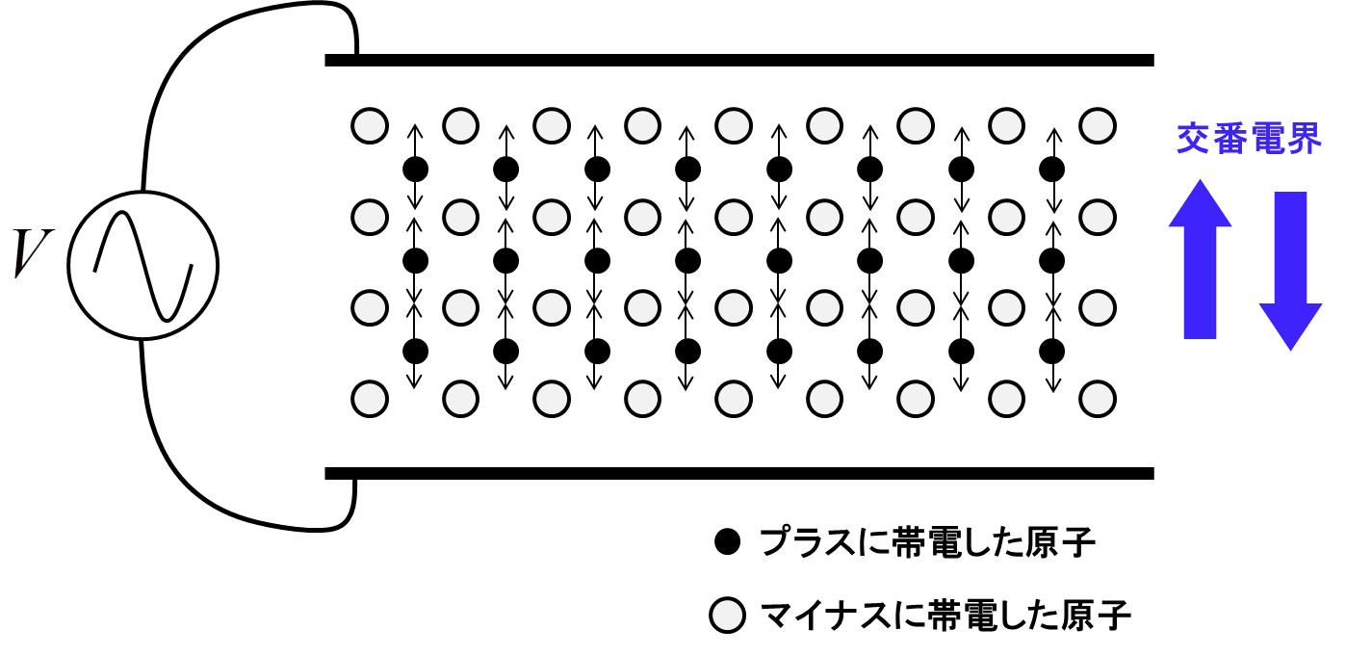
What is Dielectric Heating?
This method is used to heat an insulator (dielectric) rather than an electrical conductor.
A high-frequency electric field (electromagnetic field) is applied to the dielectric
The image of a dielectric heated by a high-frequency electric field is shown in the figure below
Alternating Electric Field
Positively charged atoms
Negatively charged atoms
Fig. Dielectric applied to high-frequency electric field

Slide 21
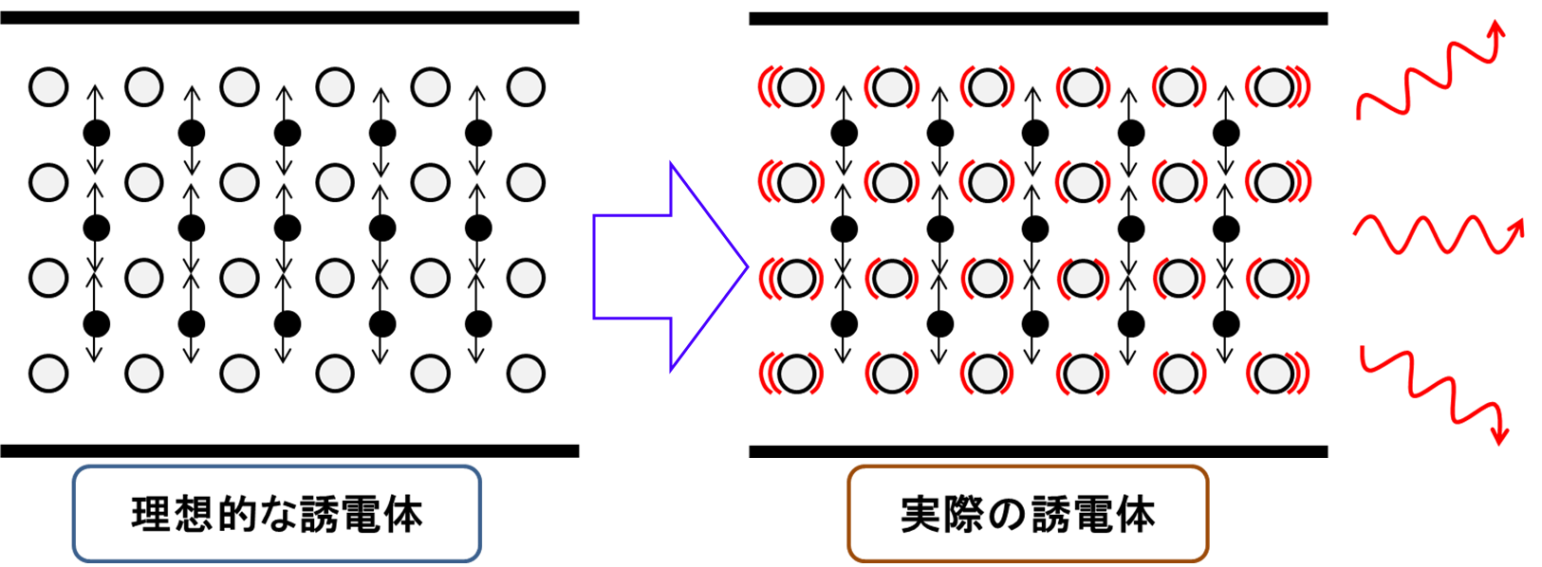
About Dielectric Heating (cont.)
How dielectric heating works
To begin with, a dielectric is a crystal in which positively charged atoms and negatively charged atoms are regularly combined. Then a high-frequency electric field is applied here, the positive and negative atoms move in opposite directions, causing periodic displacement of the lattice structure. Simply put, the lattice structure is shaken (dielectric loss). Of course, dielectric heating is possible if the molecules have polarization (polarization of positive and negative charges) even without a dielectric with a crystalline structure. The figure below shows an image of the dielectric loss.
誘電
損失
Dielectric
Loss
Ideal dielectric
Actual dielectric
In a dielectric with dielectric losses, each time there is polarization (displacement of the relative positions of the positive and negative electrodes), losses due to the vibration of the lattice occur and heat is generated. Dielectric heating is established only when this occurs.

Slide 22
Simple Explanation of How Dielectric Heating Works
＋
－
＋
－
＋
－
＋
－
＋
－
＋
－
＋
－
＋
－
＋
－
＋
－
＋
－
＋
－
＋
－
＋
－
＋
－
＋
－
＋
－
＋
－
＋
－
＋
－
＋
－
＋
－
＋
－
＋
－
＋
－
＋
－
＋
－
＋
－
＋
－
＋
－
＋
－
＋
－
＋
－
＋
－
＋
－
＋
－
Fig 1. Without Electric Field
Fig 2. When the Electric Field is Downward /
When the Electric Field is Upward
When an electric field is applied to a dielectric, it aligns in the direction of the negative of the molecules facing the positive direction of the electric field, as shown in Fig 2 above. This is the image of a crowded train with everyone aligned facing the direction the train is moving. When the direction of the electric field changes, each molecule re-aligns 180 degrees in the opposite direction. A crowded train suddenly starts to run in the opposite direction, and all the molecules re-align in the opposite direction. When everyone in a crowded train changes direction, their bodies touch each other and become hot like "oshikura-manju” or pushing one another for warming.
Dielectrics also emit minute heat due to friction when molecules change direction simultaneously, but the temperature does not rise at frequencies of a few 10 kHz. However, at 1 GHz (1 gigahertz), where the molecules change direction one billion times per second, the heat generated is considerable. This is done at ultra-high speed by dielectric heating.
Dielectrics are composed of positively and negatively charged molecules, and in the absence of a normal electric field, each molecule exists in a disjointed orientation, as shown in Fig1 above.

Slide 23
Thank you
www.avio.co.jp
www.easleyllc.com

