Slide 1


Introduction of Welding Applications
November 2023
Presented By

Slide 2
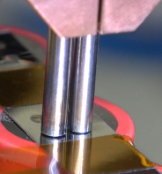
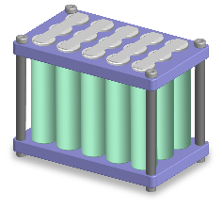


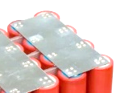



Battery Weld Application- Cu Tab
Battery
Sn plating
Copper-alloy tab
Cylindrical battery
Why use Copper-alloy tab?
Battery Performance Improvement
High electric and thermal conductivity suppresses temperature rise
-Reduce high-current charging/discharging time
-Increase battery cell life
Cost Reduction
Material cost is lower than nickel
No projection or slitting process is required, reducing the manufacturing process

Slide 3
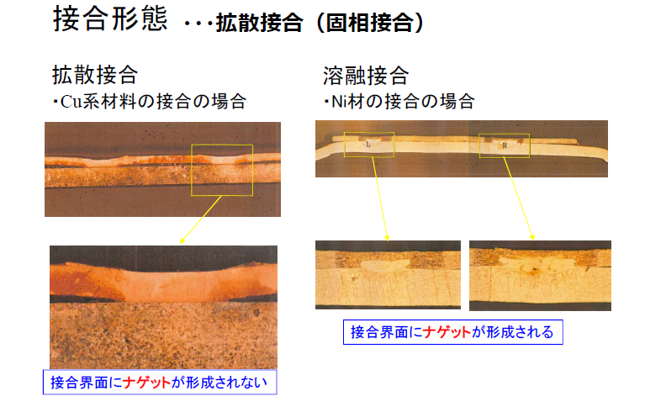
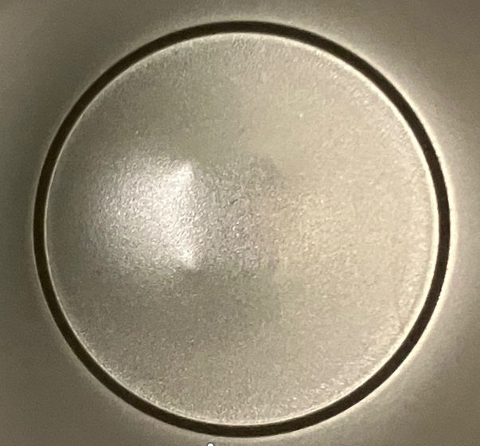
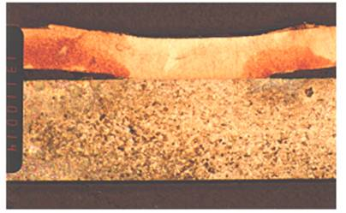
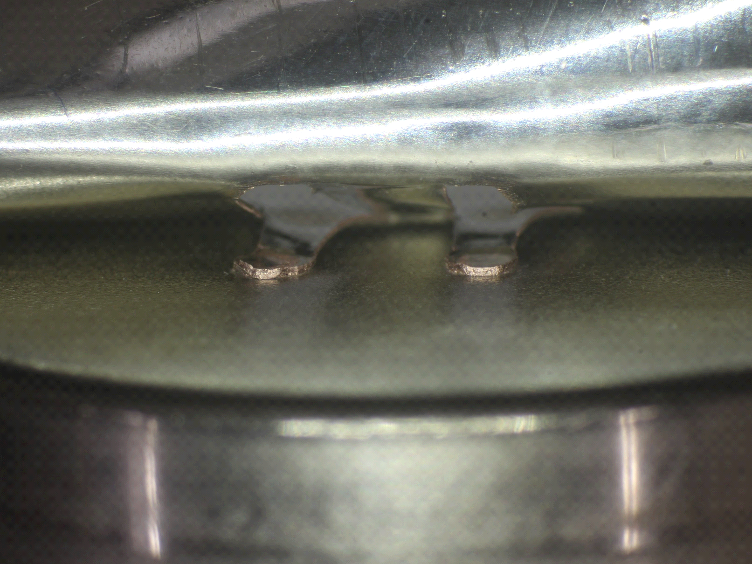
Battery Weld Application- Cu Tab (continued)
Nickel and copper-alloy bonding form differences
Nickel
Welding example (peeled joining area)
Nugget is formed at the bonding interface
Joining area between Ni tab and battery case
Welding example (cylinder side)
Cu Alloy (Sn Plating)
Welding Mark
(No melting)
Nugget is NOT formed at the bonding interface
Joining area between Cu alloy tab and battery case

Slide 4
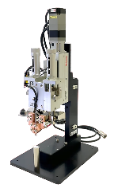
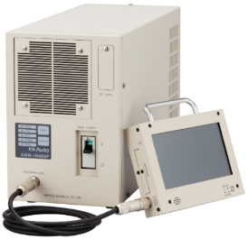
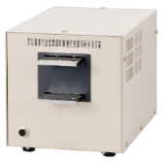
Battery Welding Application- Avio Improvement
Avio Resistance Welder Benefit
Enable high quality welding of copper alloy tabs, which is difficult for previous welding controllers
Fast ramp-up for quick heat generation
High peak current hold for longer welding time allowing diffusion bonding
Image of current waveform
Current
Avio
High-Reliability Inverter Type Resistance Welder
Avio NRW-IN400PA/NT-IN8444B
High
Fast
ramp-up
High peak Current holding
Time
High welding cycle
Current
Competitor
Control Frequency: 5 kHz
Maximum Weld Current: 8,000A
(Transistor-type)
Ideal for Battery Tab Welding!
Time

Slide 5
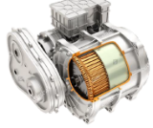

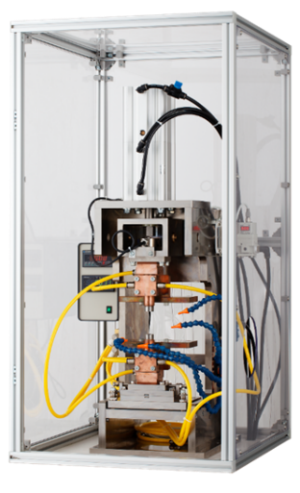
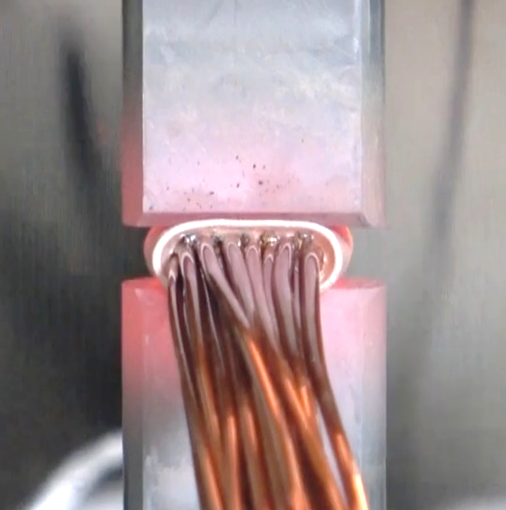
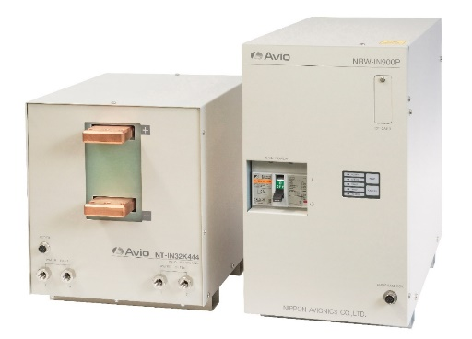
Wire Fusing Weld Application
Motor
Multiple insulated wires
Terminal
High-Reliability Inverter Type Resistance Welder
Avio NRW-IN900P/NT-IN32K444B
Control Frequency:5kHz
Maximum Weld Current: 32,000A
Why is wire fusing better than soldering?
Direct joining without solder has higher connection reliability
  Heat resistance improvement
  Vibration resistance improvement
High productivity
  No insulation stripping required
  Shorter process time
Ideal for Wire Fusing!

Slide 6
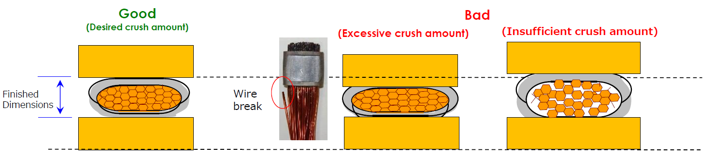
Wire Fusing Welding Application
What is Wire Fusing?
Deformation by heat and pressure allows the insulation to be removed while ensuring electrical conduction and strength of the bond… “Fusing” method
Pressure
Current flows only in the terminal
The insulation is removed and current flows through the wire to heat and bond
Electrode
First
Current
Second Current
Covered Wire
Terminal
Electrode
Heating terminal
Complete the joining
Precise control of the crush finish dimensions are required to ensure the quality of joining

Slide 7
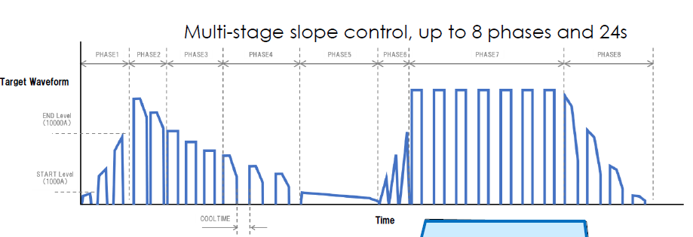

Wire Fusing Welding Application- Avio Improvement
Avio Resistance Welder Wire Fuse Benefit
[Pulsation Mode]: Precisely control the heat input with fine, “pulse like” current control
Gradual heating prevents excessive crushing
Pulsation Mode
Conventional
Sensor Input Compensation
Adjust current output based on predetermined PLD settings
Added control using input of external pulse signals including displacement sensors and current output level correction during the weld process
Fine tune crush level and better control insufficient or excessive crush
Current
Reduce current output to
maintain proper crush
External signal

Slide 8
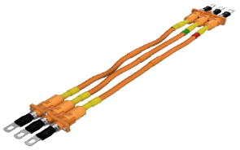
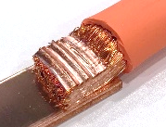
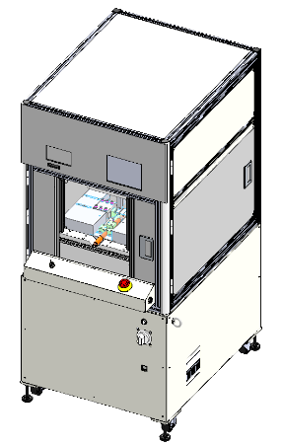

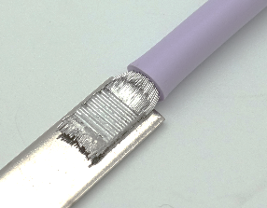
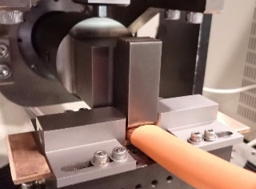
Harness Welding Application
Harness
Copper Harness
High Power Ultrasonic Metal Welder
SE-10K (Provisional Name)
New Product
Aluminum Harness
Scheduled to be released in 2024!
Control Frequency:20kHz
Maximum Output Power: 10kW
Ideal for Harness Welding!
Why is direct bonding better than crimping?
High connection reliability
Low contact resistance suppresses heat generation
  Improvement of bonding strength, heat resistance and vibration resistance
Capable of joining dissimilar metals
  Join aluminum harnesses and copper terminals
  Weight reduction from utilization of lighter materials

Slide 9
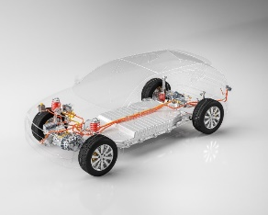
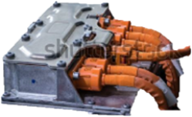
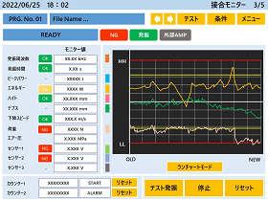
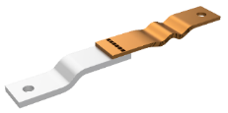
Harness Welding Application- Avio Improvement
Ultrasonic metal welder benefit
Process time reduction using 10kW high power
Larger diameter stranded wire, such as 100SQ class, can be joined in just a few seconds
Extensive monitoring functions improves quality control
Better equipment maintainability and control
[Run chart monitor]
Visualization of process transitions
Judgment of joint results
Monitor for proper replacement of joining tools
Monitor for predictive failure
Applicable assemblies:
High voltage harness
EV aluminum harness
EV bus bar
High-capacity laminated battery (laminated foil and tab)

Slide 10
Thank you
www.avio.co.jp
www.easleyllc.com

